Slide 1
Does Business Structure effect a business’s life Cycle?

Slide 2
Introduction
Natalie Toler
MSDA Student

Slide 3
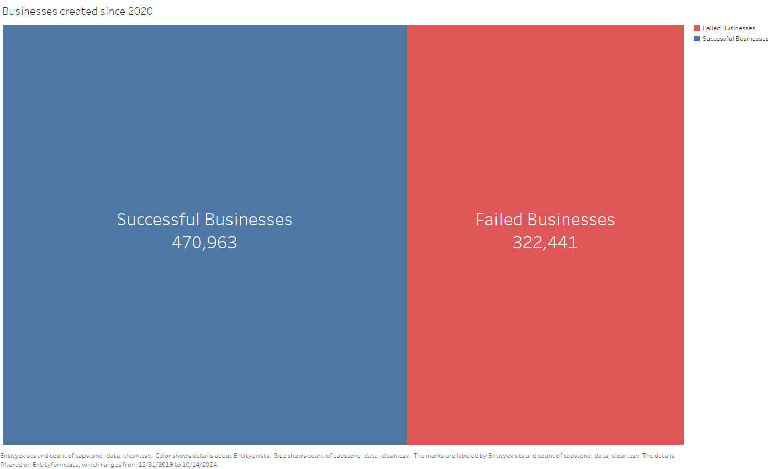
Business Entities registered in Colorado Since 2000
From The Colorado Information Marketplace

Slide 4
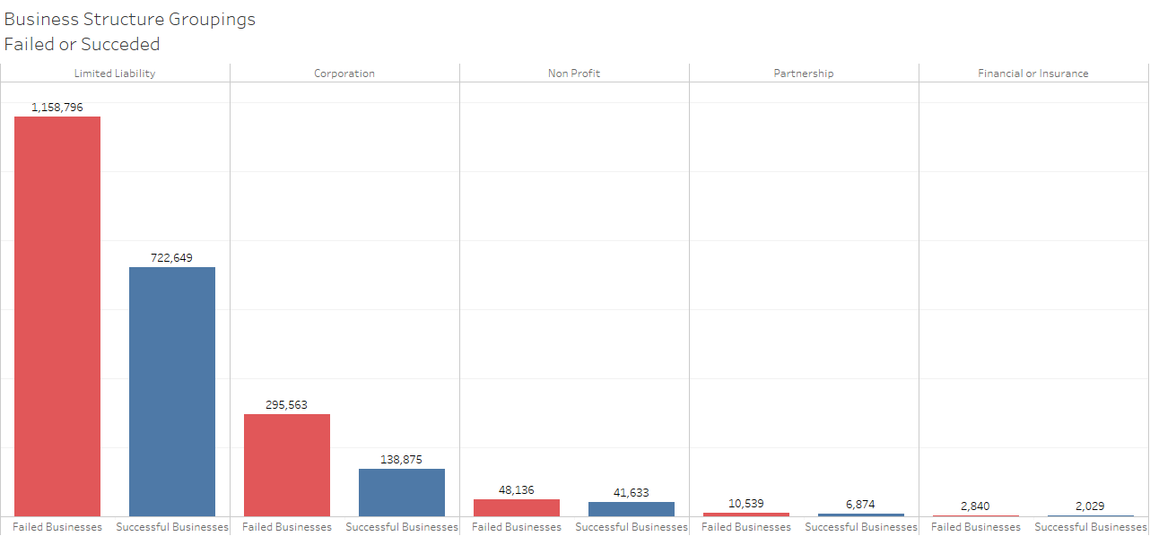
Business Structures

Slide 5
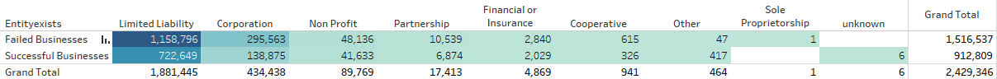
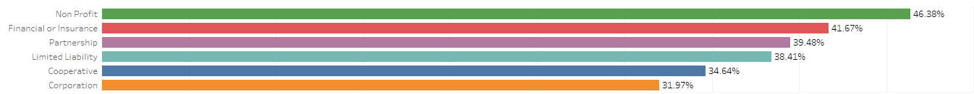
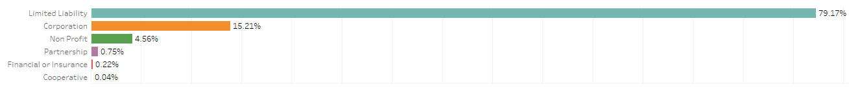
Chi-Square Test of Independence
Contingency Table
Expected Survival Rates
Actual Survival Rates

Slide 6
Findings
There is a significant difference in the survival rates among various businesses registered in Colorado.

Slide 7
Proposed Actions
Funding for further analysis:
Study business success rates over time.
Gathering further data that can help explain why businesses closed to add to the study.
Recommendations:
Policymakers focus on creating support for business types with lower survival rates.
Education to entrepreneurs about business structures

Slide 8
Benefits
Reducing the failure rate of businesses.
Broadening our understanding of the Business life cycle
Contributing to economic Growth and Stability.

Slide 9
Thank you

